Slide 1

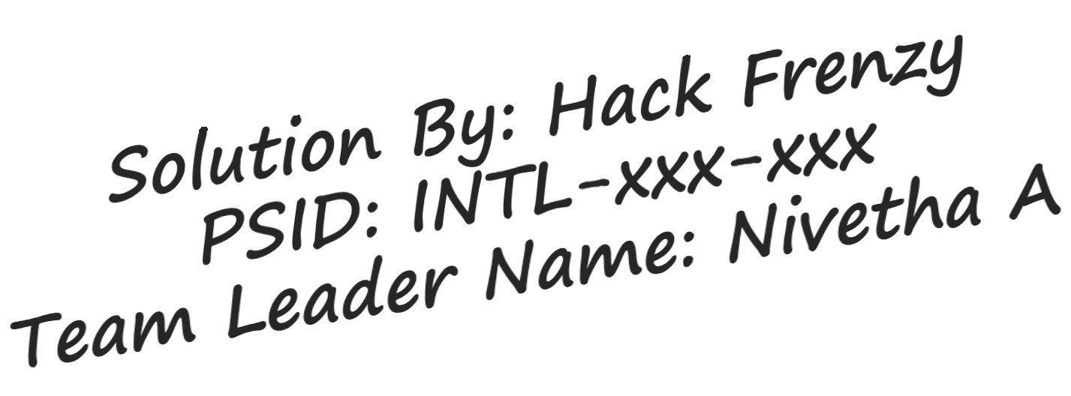


Slide 2


Idea Introduction
IDEA TITLE- BASELINE
Resources Used
Any Third Party
API/Services used
1. Natural Language Processing
2. Twitter API
Tech Stack
Any Third Party
Tech Stack
1. HTML
API/Services used
1. Google Cloud
Natural Language API
Twitter API
1. HTML
1. Research
2. CSS
Papers
3. Flask
2. Articles
IDEA-OUTCOME – UNDOHATE
4. Python
3. Datasets from Kaggle
Our project is a elegant website which takes text, image, video, audio input from user and detects the hate percentage in the given input.
It uses Machine Learning, Deep Learning and Natural Language Processing(NLP) technique to identify emotion in the text.
It also shows the hate words by highlighting it.
It automatically identifies the twitter post with hatred based on real incident

Slide 3





Our Approach Towards Idea
Project Undohate
Using Machine Learning (ML),Deep Learning and Natural Language Processing (NLP )Technique ,our project detects the emotion in a given text ,identifies and hides hate words and offers suggestions to remove hate content using Natural Language API.
Targeted problem:
Innovation or
Functional
feature added:
requirement in
Hate content has
We are adding a
further development:
become too common in
feature which presents the person who posted with date, time, who liked, commented, and shared the post with hatred in twitter using Twitter API.
this social media
This project will prove very
century.
useful when integrated with other
social media.
It is very important
to follow proper
The users will we given alert
conduct.
message when they type hate
• Our project also shows the Hate words by highlighting it for the user to know which kind of word to avoid
words in social platforms.and will
be given suggestions
Our project helps
people to avoid posting
hate content.
Using Computer Vision and
Image analysis algorithms and
Our idea for this
techniques image and video hate
problem is to identify
identification can be added as part
hate content and also
of parental controls over apps.
provide suggestions to remove hate words.

Slide 4

Team Slide
Nivetha A
Priyadharshini B
Nandhini V
Back-End Developer
UI/UX Designer
Front-End Developer
Team Leader
Project Co-ordinator
Project designer
Arthika G
Arshath B
Rohini M
Front-End Developer
Front-End Developer
Domain Expert
Project Manager
Data Scientist
Team Mentor

Slide 5







Development Pipeline
Documents for
Third party API :
installation
Natural Language Processing
and evaluation
1. python packages such as profanity_filter, nltk.sentiment, speech_recognition, pytesseract, moviepy.editor
2.flask
3.sklearn
Twitter API
Proposed
Repository Link
Proposed UI and
Development Plan
1.Analyse dataset
or Reference link
functional flow
of folders
https://drive.google.com/drive/folders/1fuq4-fES55REhT_ACWkIANgVL9M7Aa6A
1. Home Page
2.Train the model
2. Text, image, video, audio analyser page.
3.Get input text
4.Identify hate
content
3.Tweet Identifier Page
4. Emotion score chart
5.Predict emotion
Step A
Step B
Step C
Step D
Step E

Slide 6



Vision of Innovation/Idea/Solution
Explain How you developed Idea How you idea is different and innovative
form other ideas- a default comparison
In identification of hate content, we first
focused on hate identification in text
Identifying hate content is being used
inputs using Deep Learning. We have
commonly in many social platforms.
trained our model with an effective
But our project also offers an additional
dataset which identifies hate content and
functionality of highlighting hate content
predicts the emotion in the input. As the
by showing the emotion score.
next step we focussed on proving
suggestions to remove hate content.
How much time it will take in
Any early stage innovation detected
conversion as a final product
while developing the solution
Our project can be fully completed
Initially, our idea was only identification of hate content. But after identifying hate content we tried on giving suggestions to remove hate content. After lot of research, we found the Natural Language API to implement the
functionality.
in a time duration of one month.

